Slide 1
National African American Women’s Leadership Institute
NARBW Meeting
Friday, May 21 2021
Christina Stallings & Dana Robles

Slide 2
NAAWLI Vision and Mission
We see leadership in you…..
VISION
NAAWLI is the premier resource to connect, educate and empower African-American women leaders to serve as trailblazers for global transformation.
MISSION
NAAWLI’s objective is to accelerate the leadership potential of African- American women leaders.
Notes:
The National African American Women’s Leadership Institute is the premier resource to connect, educate and empower African-American women leaders to serve as trailblazers for global transformation.
NAAWLI’s mission is to accelerate the leadership potential of African-American women leaders.
(1 min)

Slide 3
NAAWLI History
We see leadership in you…..
Co-Founders: Dr. Gloria Scott and Zulma X Barrios
Founding Chair: Barbara Toliver-Haskins
Founded: Bennett College in Greensboro, NC in 2000
Status: Texas Non-Profit Corporation, Section 501(c)(3) and trademarked
Title Sponsor: State Farm Insurance Companies
NAAWLI Headquarters moved to Dallas, TX in 2006. 262 women have completed the NAAWLI Leadership Development program to date.
Notes:
NAAWLI was founded in 2000 by Co-Founders Dr. Gloria Randle Scott – an Educator and Trailblazer who was the first African American teacher at Indiana University, and the first African American National President of the Girl Scouts of the USA – and Zulma X Barrios – a multicultural Consultant who worked in the international insurance arena and became the first woman General Manager for the Mutual of Omaha Companies. The founders of NAAWLI have always been committed to developing the leadership talents of women to better themselves and their companies, and they continue their work today!
NAAWLI is a registered non-profit organization in the state of Texas, and State Farm is the title sponsor of the organization. To date, NAAWLI has impacted the lives of over 260 women in its 21 year history.
(1-2 min)
[Jan 2021 article on Dr. Scott for more info on accomplishments - http://www.thebendmag.com/2021/01/21/343443/meet-dr-gloria-r-scott]
[2010 article on Ms. Barrios for more info on accomplishments - https://sites.google.com/site/lasangrellama/family-profiles/zulma-x-barrios-l-h-d]

Slide 4
NAAWLI Curriculum
Sessions in NAAWLI’s Leadership Development Program are centered around 8 Core Tenets:
Community Service
Entrepreneurship
Leadership
Mentorship
Networking
Organizational Culture
Presentation & Branding
Self-Care
Notes:
The design of the NAAWLI leadership development program is purposeful, with 3 week-long sessions held in March, June and September.
The 2021 program is all virtual, with 27 current fellows or participants representing various corporations and small businesses - CSX, State Farm, Erie Insurance, Texas Instruments, Bell Helicopter, Medaille College, Gwinnett County Schools, Go Dream Forward, and Genesis Disability Services.
The fellows interact with several powerful and influential instructors that work for Fortune 500 companies facilitating each program session.
(1-2 min)

Slide 5
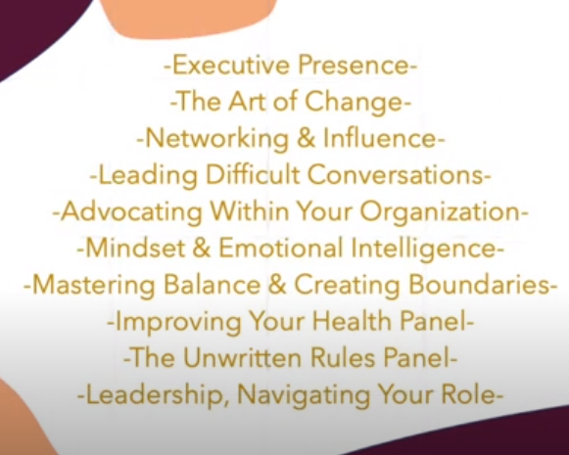
Session One Recap Video: March 22–26, 2021
We see leadership in you…..
https://drive.google.com/file/d/1W93Lm6mOXhjDqdtvwi63cGE33BA99dg-/view?usp=sharing
Notes:
I’m going to play this video for you to get a glimpse into what Session One was like for the program Fellows, Instructors and NAAWLI Board of Directors - Impactful curriculum, engaging instructors, and having some fun with co-fellows!
(10 min, Play Video With Sound) - https://drive.google.com/file/d/1W93Lm6mOXhjDqdtvwi63cGE33BA99dg-/view?usp=sharing
.
As a result of just the first session of the leadership development program held for one week in March, survey results reported that Fellows experienced the following outcomes:
Stronger executive presence.
Increased confidence and assertiveness.
Clearer leadership and career navigation.
Increased presentation and interviewing skills.
Clarity around goals, needs and expectations.
Increased ability to navigate and direct organizational changes.
Enhanced empathy and sensitivity surrounding advocacy for others.
Prioritization surrounding psychological, mental and emotional safety.
Strong desire and skillset to advocate for other women within the organization.

Slide 6
Contact NAAWLI
We see leadership in you…..
Applications for the 2022 Leadership Development Program will be
available soon on NAAWLI’s website.
Sponsorship opportunities are available to support the continued success
of the NAAWLI program.
Contact the NAAWLI Executive Director and Board of Directors to learn how
your organization can partner with NAAWLI!
Email: info@naawli.org
Website: www.naawli.org
Notes:
[Share personal experience with NAAWLI leadership development program.]
As you think about the information shared today, ask yourself what do women of color need from their employers right now given the climate today?
What attributes should a corporation seek in a professional development program?
How can corporations foster the growth and development of your women of color employees?
Please reach out to the NAAWLI organization! The Executive Director will be happy to meet with you to discuss opportunities for partnership. Thank you!
(5 min)

