Slide 1
Effective Meetings
Krista Keene

Slide 2
Most Effective Meeting Least Effective Meeting
Notes:
Think of a meeting you were in that was most effective. Did you lead it or attend? What sets it apart?
Think of a meeting you were in that was least effective. Why? Behaviors? Location?

Slide 3
Why do we have meetings?

Slide 4
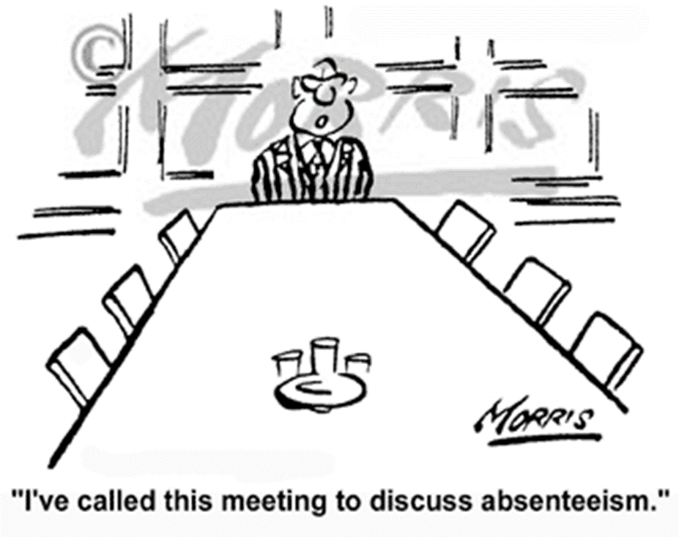
Meeting Purpose
Share information
Agree on direction
Make decisions
Find solutions
Notes:
Ad hoc – short convo, limited people
Issues – controversial, negotiation or compromise
Status – project update
Working – solve problem, make decision
Strategic – brainstorming, off-site, several days

Slide 5
What is an effective meeting?
Pre-planned
Conduct meeting
Follow-up
Prepare
30%
Conduct Meeting
40%
Follow-Up
30%
Notes:
Prepare – agendas, certain decisions, review location, review attendees, remind
Meeting – stick to agenda, ask pointed questions, assign action items
Follow-up – get results

Slide 6
Planning the Meeting Setting an Agenda
Include start time and end time
If possible, allocate time to major agenda items
Always allow time for around the room introductions
Clearly define the purpose of the meeting
Identify lead for each agenda item
Allowance for additional agenda items

Slide 7
Conducting the Meeting
Set ground rules
Keep the meeting agenda
Assign timekeeper
Assign note taker
Parking lot
Action log
Number of commenters
Respect
Notes:
Be prepared
Minimize multi-tasking
5-minute rule
Parking lot – not on agenda, lengthy discussion, tangents
Action log – who is doing what and by when
Don’t say “that will never work”, Ask “how do you know?”

Slide 8
Meeting Follow-up
Distribute clear simple meeting notes within 24 hours
Verbatim reports are not necessary
Set a follow-up meeting, if necessary
Stay involved

Slide 9
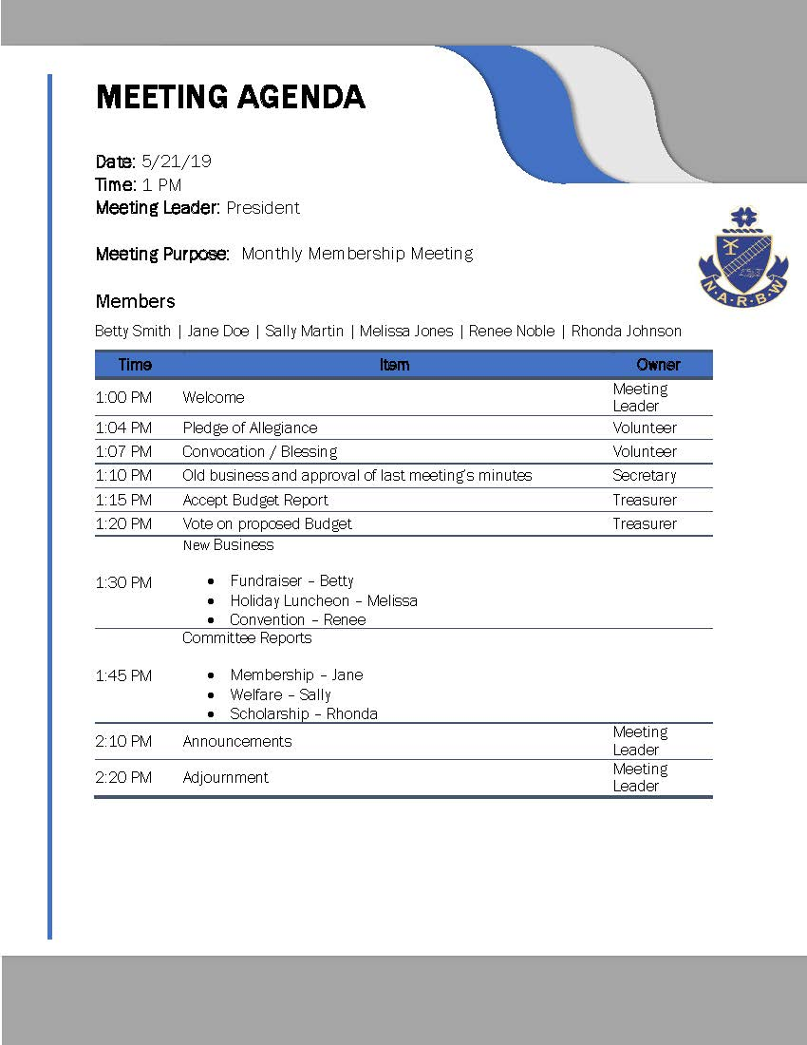
Sample Agenda

Slide 10
Lessons Learned Do’s & Don’ts
Do’s
Don’ts
Right people in attendance
Thoughtfully schedule
Start and end on time
Follow the agenda
Manage the discussion
Summarize key decisions and next steps
Confirm action items
Discard the agenda
Digress
Allow tangents
Go over the scheduled time
Negativity
Think that time = better results
Discuss too many topics at meeting

